Slide 1

PPP OPPORTUNITIES
IN RESPECT OF TOURISM-RELATED ACTIVITIES IN THE
iSIMANGALISO WETLAND PARK – APRIL 2025

Slide 2
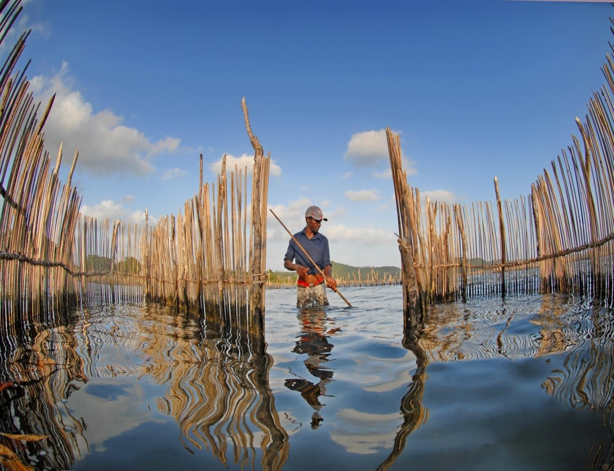

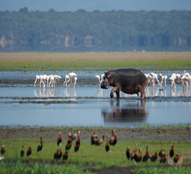

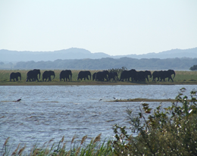
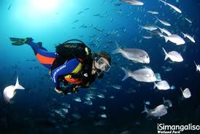
CONTENTS
Brief background of iSimangaliso Wetland Park
PPPs in iSimangaliso Wetland Park
Key attributes of PPPs
Overview of the Tourism Activities
Key bid requirements
Evaluation Criteria
uKhahlamba WHS

Slide 3
A BRIEF BACKGROUND
iSimangaliso Wetland Park of the iSimangaliso Wetland Authority was proclaimed a World Heritage Site by regulation published in the Government Gazette under notice number 4477 on 24 November 2000.
The total area of new iSimangaliso MPA(Marine Protected Area) 1 328 901 ha and comprises 9% of South Africa's coastline under formal conservation hectares in size. The Indian Ocean forms the eastern boundary of the Park, which extends from the Mozambican border in the north, to Maphelane in the south and includes the uMkhuze section in the west.
The Park traverses approximately one-third of the KwaZulu-Natal coastline.

Slide 4
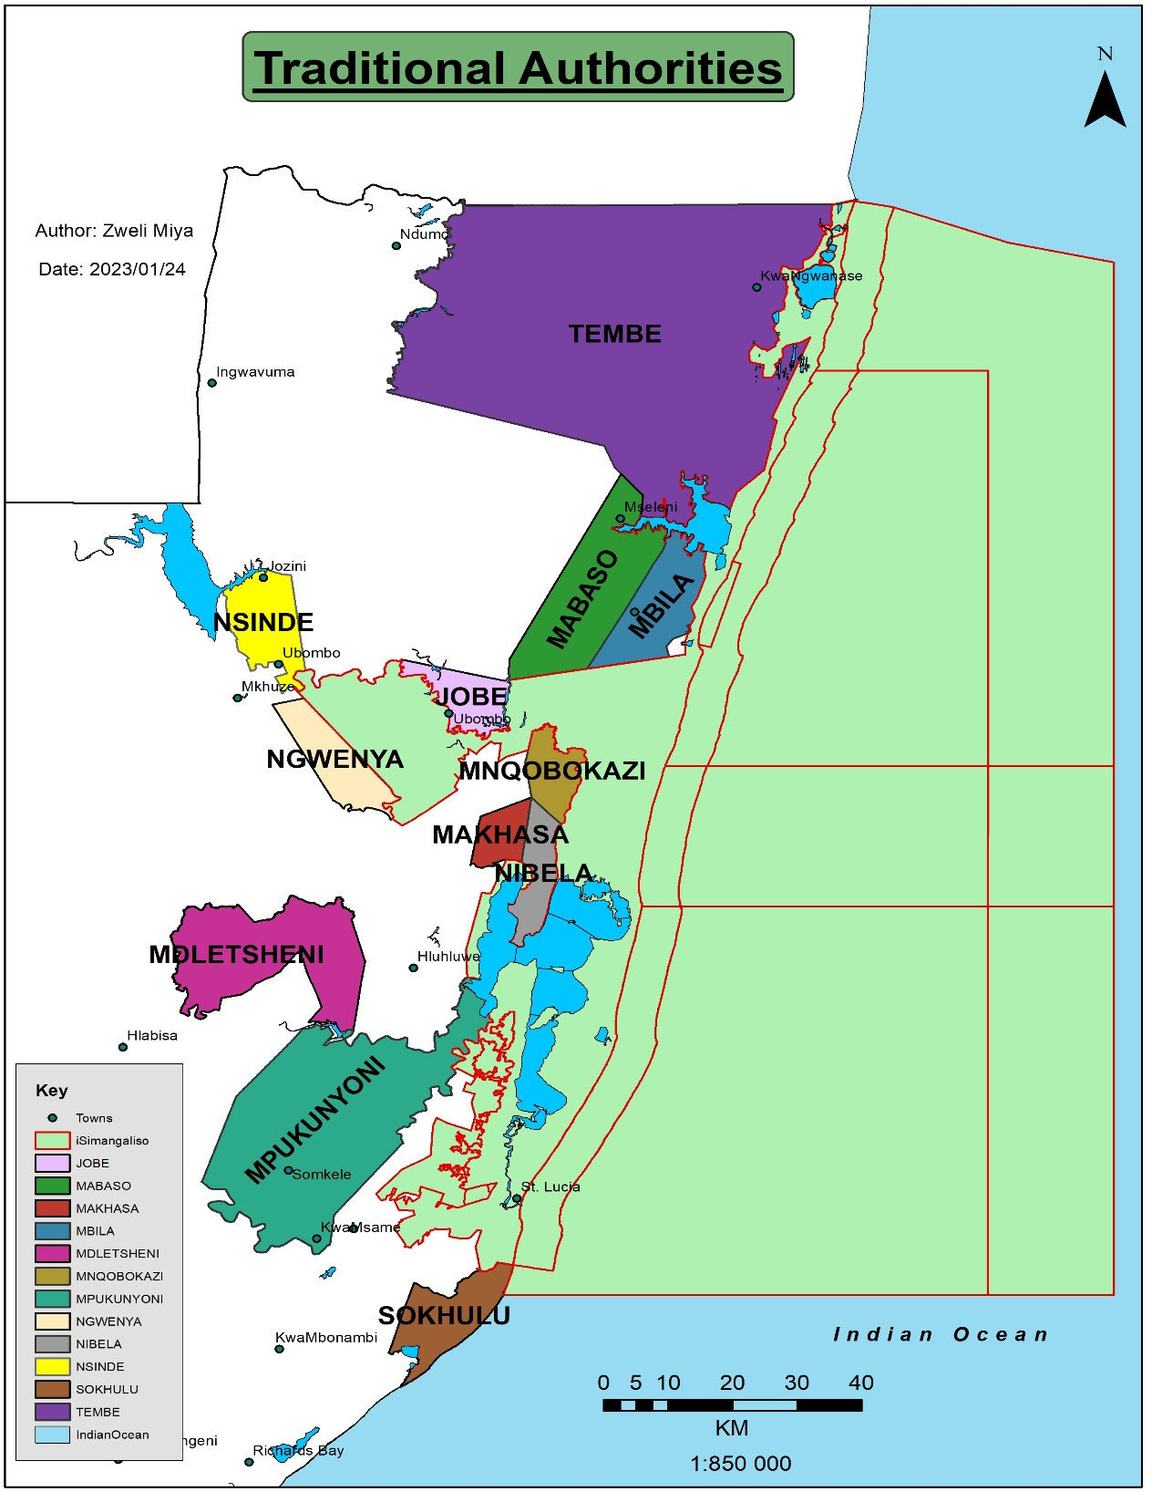
Municipalities
12 X Traditional Authorities
Districts
King Cetshwayo
uMkhanyakude
Local Municipalities
uMhlabuyalingana
Jozini
Big Five False Bay
Mtubatuba
Umfolozi
Tembe
Mabaso
Mbila
Jobe
Nside
Ngwenya
Mnqobokazi
Makhasa
Nibela
eMdletsheni
Mpukunyoni
Sokhulu

Slide 5
B. Vision ,Mission and Objective
Vision
Mission
Objective
To protect, conserve, and present the Park
To promote and facilitate optimal tourism and related development in Park
To encourage job creation and ensure benefit flow to communities
To financial sustainability.
A renowned World Heritage Site, where wonders never End
To be a World Heritage Site celebrated for its sustainable conservation practices, offering unparalleled experiences and equitable sharing of benefits. Through applying sustainable commercialization practices, biodiversity conservation and community development to protect, preserve and present iSimangaliso Wetland Park for local and global appreciation.

Slide 6
C. PPPs in iSimangaliso Wetland Park
“To reduce the dependence on state funding and improving existing operational efficiencies.”
The National Treasury Regulation 16 to the PFMA defines a PPP:
Contract where private party performs an institutional function and/or uses state property for commercial purposes
Private party assumes substantial financial, technical and operational risks
Private party receives a benefit (service tariff or user fees or both) from institution budget or public or both
uKhahlamba WHS

Slide 7
C. PPPs in iSimangaliso Wetland Park
PPP framework includes:
  risk transfer from state to private sector
  Guaranteed income stream to the state
  Community benefits
  Environmental practice
uKhahlamba WHS

Slide 8
STRATEGY: COMMERCIALIZATION
Objectives that guide the iSimangaliso’s commercialization strategy include:
  Revenue generation for the institution
  Loss minimization or savings on existing operations
  Optimal utilization of under-performing assets
  Job creation
  BEE/ Transformational goals.
  Infrastructure upgrades
  Tourism promotion
  Further biodiversity protection and conservation

Slide 9
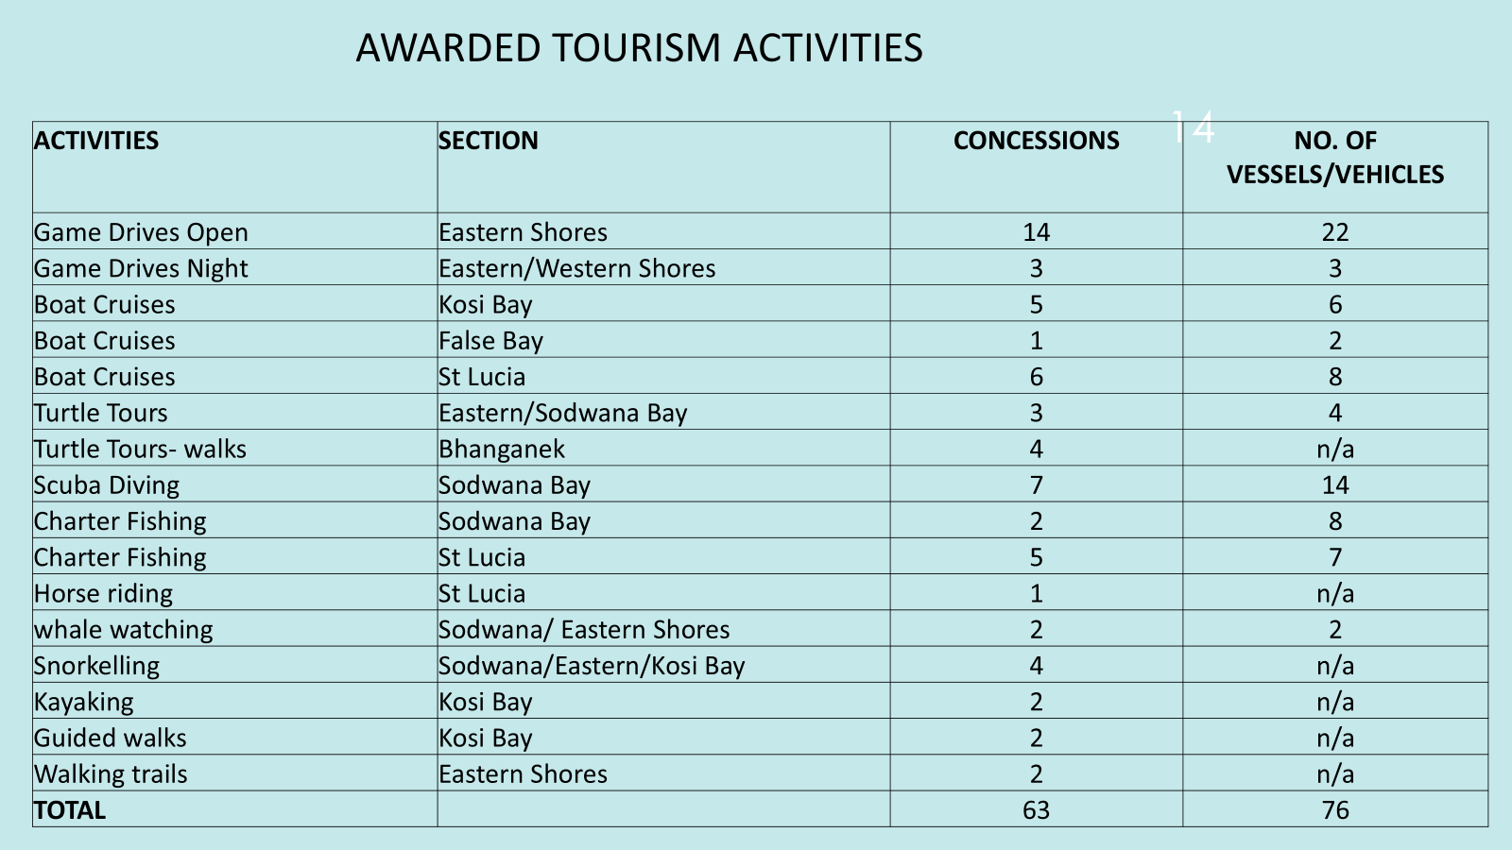
EXISTING TOURISM ACTIVITIES
uKhahlamba WHS

Slide 10
E. Overview of the Tourism Activities
Area | Game Drive | Guided walks | Scuba Diving | Turtle tours vehicle | Fishing Charters
Eastern Shores/Western Shores | 1
False Bay |  | 1
Sodwana |  |  | 1 | 1
Kosi Bay
St Lucia |  |  |  |  | 1
Total | 1 | 1 |  | 1 | 1

Slide 11
F. DESCRIPTION OF ACTIVITIES
FISHING CHARTERS
Activity concept | Offshore in St Lucia
Area of Operation | The ocean, sandy beaches and rocky areas along the coastline, except in sanctuary zones. (refer zonation map for no-take, tag and release zones)
TURTLE TOURS VEHICLES
Activity Concept | Tracking of turtle breeding sites by vehicle in Sodwana
Area of operation | Sodwana from Adlams to Nine Mile
GAME DRIVES - OPEN VEHICLE
Activity concept | Guided game drives on public roads in the Park.
Area of operation | Public roads on Eastern Shores to Cape Vidal; or UMkhuze; Western Shores; False Bay; Sodwana; Kosi Bay; Lake Sibaya
GUIDED WALKS & WALKING TRAILS
Activity Concept | Travel by foot to indicated viewpoint or node for day trails (ie trails are between sunrise and sunset).
Area of operation | On designated routes in the Eastern Shores section of the Park & Kosi Bay Section False Bay and Kosi Bay

Slide 12
SCUBA DIVING
Activity Concept | Day time diving with scuba equipment on coral reefs exploring underwater marine environment. Night time diving, subject to the prior written consent of the Authority and subject to proof of appropriate qualifications and registrations of the divers and the vessel.
Area of operation | Sodwana Bay on designated reefs

Slide 13
TIME TABLE
Event | Date
Advertising and RFP issued | 28 March 2025
Registration for Due Diligence/Clarification Meeting. RSVPs to be emailed to: ppp@isimangaliso.com | 11 April 2025
Due Diligence/Clarification meeting referred to in the RFP | 23 April 2025
Training/Workshop on compiling PPP Tender Documentation (attendance is optional via Microsoft Teams) .Bidders to RSVP via email ppp@isimangaliso.com | 30 April 2025
Questions of clarification - closing date | 16 May 2025
Feedback of Questions of clarification | 23 May 2025
Bid submission closing date | 29 June 2025

Slide 14
Evaluation Criteria
  The three main elements of the bid and the two-Envelope system:
  Bids will be evaluated on three main elements: Functionality, Bidder’s proposed B-BBEE/Transformational commitments and the PPP Fee Offer.
  Envelope 1 is for Functionality and is opened first. Bidder must score at least 70% for Functionality
  Envelope 2 contains the Bidder’s proposed B-BBEE commitment, as well as the PPP Fee Offer and will only be opened and evaluated if the minimum threshold under Functionality is met.

Slide 15
Envelope 1
The functionality aspects of a bid will be scored out of 100 points. A Bidder must achieve 70% of the total Functionality points in order to pass. Functionality is made up of the elements and weights as outlined below:
Elements | Financing & Capital Plan | Business and Operational Plan | Environmental Proposal | Risk Matrix
Weight | 30% | 40% | 20% | 10%
Minimum Threshold | 50% | 50% | 50% | 50%

Slide 16
  If the Bidder meet the minimum threshold for Functionality, envelope 2 will be opened.
  The Preferential Procurement Policy Framework Act, 2000 (PPPFA) and PPPFA regulations, 2022 wherein will apply with an 80/20 split between the PPP Fee Offer and the Bidder’s existing B-BBEE rating respectively.
  The PPP Fee Offer and the Bidder’s proposed B-BBEE proposal are scored out of a total 100 points.
  The following table outlines the final score weightings:
PPP Offer | B-BBEE Existing rating
80% | 20%

Slide 17
Envelope 1: PPP offer & BBBEE Proposal
  PPP OFFER/CONCESSION FEE
  The points for the PPP Fee Offer are calculated using the prescribed price formula in the regulations of the PPPFA. The maximum points will be awarded to the qualified Bidder that makes the highest PPP Fee Offer and the remaining points being allocated pro-rata to the remaining qualified Bidders. Bidders should be aware that a minimum PPP fee might be applied. If the minimum is not reached, the contract might not be awarded.
B-BBEE Proposal (20%)
The Bidder is expected to outline their B-BBEE plans as per requirements in Annexure 3 and Annexure 8 .Bidders are to complete Annexure 9
The B-BBEE plans will be evaluated in terms of, shareholding; procurement; social responsibility; skills development; employment equity.

Slide 18


Thank you
uKhahlamba WHS

