Slide 1

RFP No. PPP01/2024-25
IN RESPECT OF CHARTERS CREEK TOURISM RESORT IN THE WESTERN SHORES SECTION OF THE iSIMANGALISO WETLAND PARK
BIDDERS CONFERENCE MEETING
09 May 2025

Slide 2
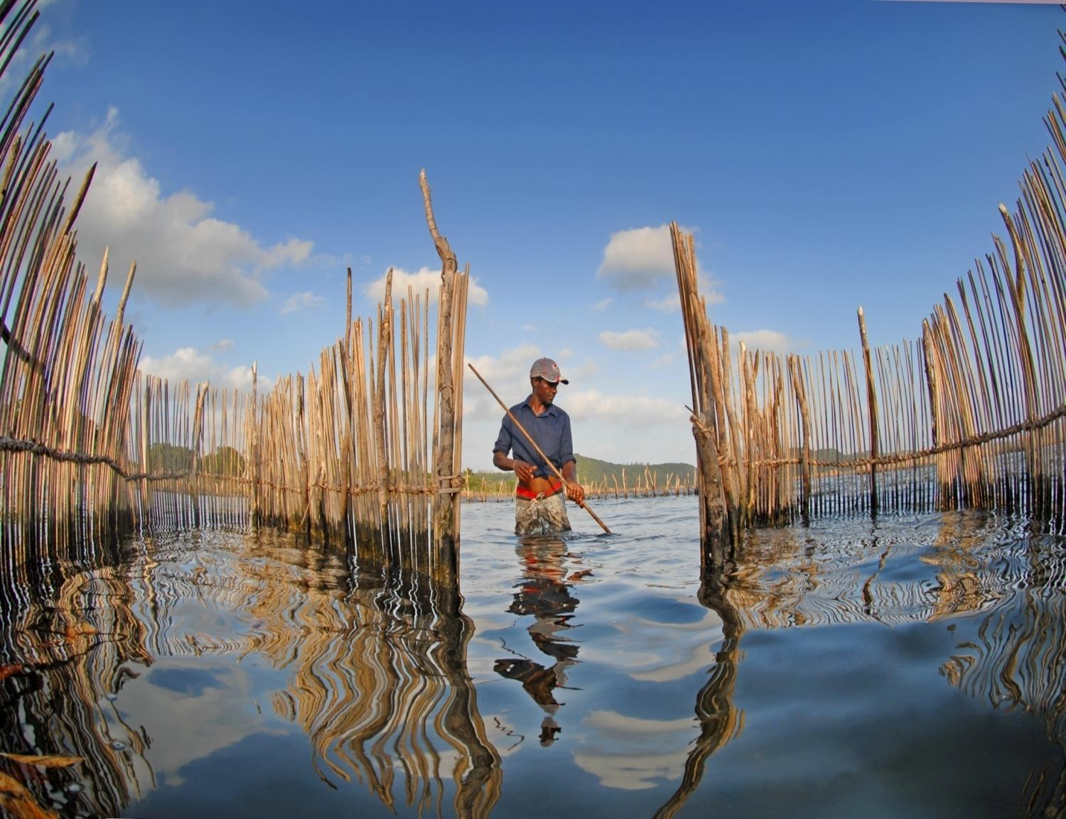

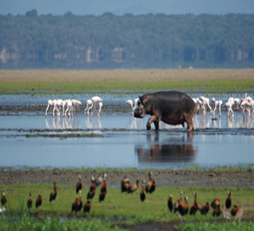

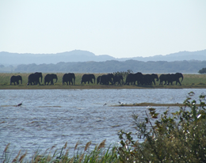
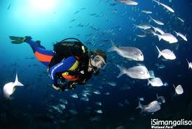
AGENDA
# | Description | Presenter
1. | Welcome & Opening | Project Officer
2. | Time for Bidders Conference (11H30 – 13H00) | Project Officer
3. | Introduction of iSimangaliso Team | Project Officer
4. | Purpose of the Bidders Conference | Project Officer
5. | Rules of Engagement | Project Officer
6. | Overview of iSimangaliso Wetland Park | Project Officer
7. | Vision ,Mission and Objective | Project Officer
8. | Commercialisation Strategy Objectives of iSimangaliso | Project Officer
9. | PPP Opportunity Presentation | Transaction Advisor
10. | Bidding Process Presentation | Transaction Advisor
11. | Bidding Time Table | Transaction Advisor
12. | Question & Answer Session | Project Officer
13. | Closure | Project Officer
uKhahlamba WHS
Notes:
Allocated time is 2 minutes

Slide 3
Purpose of the Bidders Conference
To clarify the tender process to the bidders
To ensure bidders understand what needs to be submitted
To outline the evaluation criteria
To outline the Bidding Time Table
Notes:
Allocated time is 1 minute

Slide 4
Rules of Engagement
All presentations made will be uploaded on iSimangaliso website
Questions can be posted on the chatbox during the presentation
Questions will be addressed during question and answer session
Questions must be specific to the bid under tender
iSimangaliso reserves the right to answer questions at a later stage
All bidders to type in the chatbox, Name of Representatives, Company Name & Email Address
All mics of the bidders to be on mute until Q&A session
Notes:
Allocated time is 1 minute

Slide 5
Overview
uKhahlamba WHS
Notes:
This section is allocated 5 minutes

Slide 6
Overview of iSimangaliso Wetland Park
iSimangaliso Wetland Park of the iSimangaliso Wetland Authority was proclaimed a World Heritage Site by regulation published in the Government Gazette under notice number 4477 on 24 November 2000.
The total area of new iSimangaliso MPA(Marine Protected Area) 1 328 901 ha and comprises 9% of South Africa's coastline under formal conservation hectares in size.
The Indian Ocean forms the eastern boundary of the Park, which extends from the Mozambican border in the north, to Maphelane in the south and includes the uMkhuze section in the west.
The Park traverses approximately one-third of the KwaZulu-Natal coastline
Notes:
Allocated time is 1 minute

Slide 7
Vision, Mission and Objectives
Vision
Mission
Objective
To protect, conserve, and present the Park
To promote and facilitate optimal tourism and related development in Park
To encourage job creation and ensure benefit flow to communities
To financial sustainability.
A renowned World Heritage Park where wonders never End.
To be a World Heritage Site celebrated for its sustainable conservation practices, offering unparalleled experiences and equitable sharing of benefits. Through applying sustainable commercialisation practices, biodiversity conservation and community development to protect, preserve and present iSimangaliso Wetland Park for local and global appreciation.
Notes:
Allocated time is 2 minute

Slide 8
Commercialisation Strategy Objectives of iSimangaliso
Objectives that guide the iSimangaliso’s commercialization strategy include:
Revenue generation for the institution
Loss minimization or savings on existing operations
Optimal utilization of under-performing assets
Job creation
BEE/ Transformational goals.
Infrastructure upgrades
Tourism promotion
Further biodiversity protection and conservation
Notes:
Allocated time is 2 minutes

Slide 9
PPP Opportunity
uKhahlamba WHS
Notes:
This section is allocated 6 minutes

Slide 10
PPP Opportunity
Contents:
  Introduction
  Project Objectives
  PPP Opportunity
  Question & Answers
uKhahlamba WHS
Notes:
Allocated time is 30 seconds

Slide 11
Introduction
In the western shores section of the Park, Charters Creek is located as one of the ten duels;
Charters Creek: A creek with unique flora and fauna, providing a quieter, more secluded experience for bird watchers and nature lovers;
iSimangaliso intends to procure investors to redevelop and operate the resort on a PPP basis;
Charters Creek is approx. 256 km from Durban and approx. 25 km from St Lucia;
Located 7km from the Nhlozi Entrance gate in the Western Shores section of the Park;
Approx. 40 km from Mission Rocks Beach & 60 km from Cape Vidal Beach;
The area is popular with anglers and bird watchers;
Area also boasts numerous wildlife animals, e.g elephants, buffalo, zebras and giraffes;
All vehicle access, via Nhlozi Gate or Dukuduku Gate.
Notes:
Allocated time is 1 minute

Slide 12
Introduction
An existing concession area;
iSimangaliso has vastly improved the following infrastructure over the years:
  upgrades to the chalets,
  ablution blocks;
  tarred roads and water infrastructure;
  several viewing points and hides, and a canopy walk.
The Resort comprise of the following:
# | Description | Quantity
1. | 2 Bed Chalet Unit | 10
2. | 4 Bed Chalet Unit | 4
3. | Camping site with own ablution | 12
4. | Restaurant | 1
5. | Swimming pool | 1

Slide 13
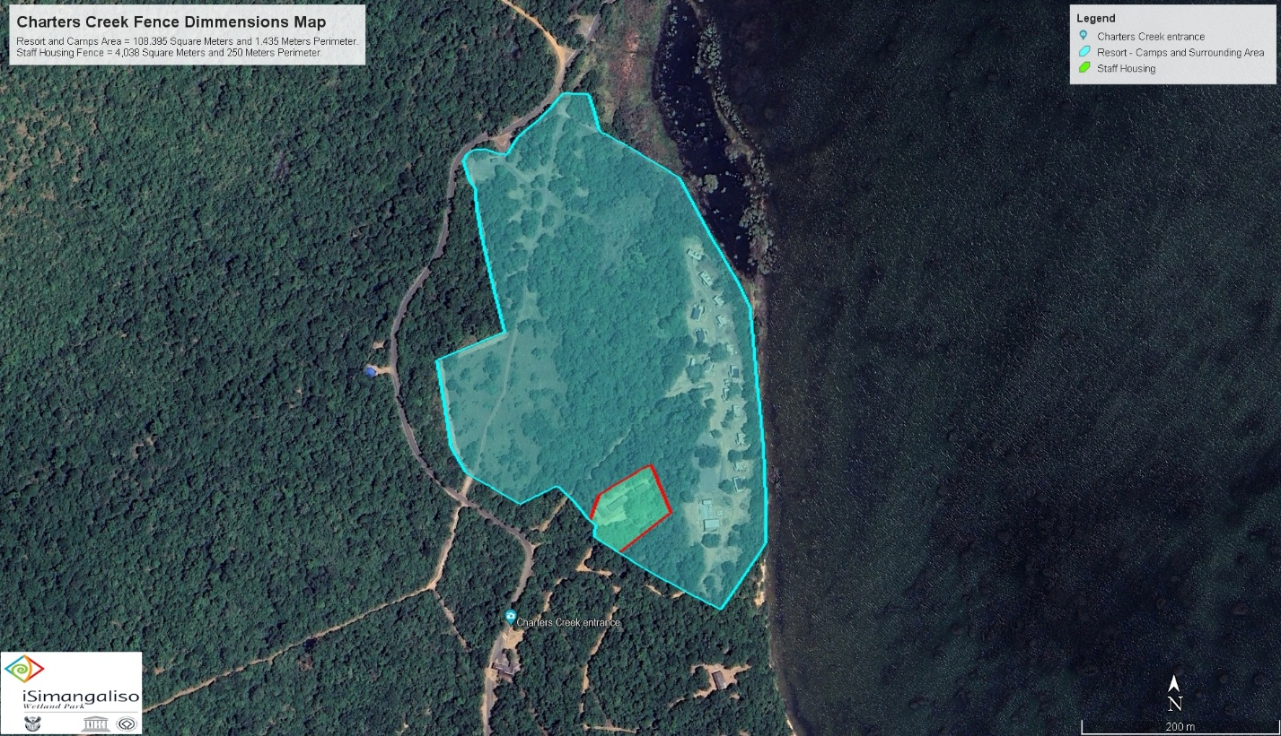
Introduction
Location of Charters Creek Resort.
Notes:
Allocated time is 1 minute

Slide 14
Project Objectives
Undertake a PPP for the resort using the Toolkit for Tourism
Compliance with the PFMA, World Heritage Act, and other prescripts of the law.
Efficient use of the project site
Enhance the attractiveness of the resort, increase tourist traffic and stay
Facilitate and fast track the redevelopment of facilities at the resort,
Ensure increased tourist numbers
Contribution to increased revenue within the Park.
Redevelop and upgrade facilities to support interpretation and enhance visitor experience.
Improve visitor’s experience at an attractive destination and generate revenue within the Park.
Redevelop and upgrade facilities that to provide 4-star lodge facilities.
Support conservation management
Notes:
Allocated time is 2 minutes

Slide 15
PPP Opportunity
iSimangaliso is inviting proposals through this RFP for the redevelopment of the Charters Creek resort.
Redevelopment to be a design, build, finance, operate and transfer (DBFOT) PPP and should deliver an attractive 4-star resort and tourist destination,
Redevelopment is envisaged to be undertaken on a brownfield project site,
Project Contract Term is twenty (20) years, including a development period of one (1) year and operations period of nineteen (19) years.
Notes:
Allocated time 2 minutes

Slide 16
PPP Opportunity
Bidders are required to submit their own comprehensive proposals which will include:
  Demand & revenue assessment,
  Financial & capital plans including a comprehensive financial model, NPV, IRR, ROI etc,
  Financial model to be submitted in an editable format i.e. MS Excel.
  Value for money outputs,
  Risk management plan including a risk matrix,
  Business & operations plans including maintenance plan,
  Environmental plans,
  Marked-up PPP agreement,
Notes:
Allocated time 2 minutes

Slide 17
Bidding Process
uKhahlamba WHS
Notes:
This section is allocated 10 minutes

Slide 18
Bidding Process
Contents:
  RFP Document
  Bidding Time-Table
  Evaluation Criteria
  Bid Submission
  Procurement Process
  Question & Answers
uKhahlamba WHS
Notes:
Allocated time is 30 seconds

Slide 19
RFP Document
Background Information
Legal, Regulatory & Institutional Framework
Integrated Management Plan
iSimangaliso Commercialisation Strategy
Value For Money Objectives
B-BBEE/Transformation
The PPP Charters Creek Tourism Resort PPP Project Opportunity
Utilities And Facilities Management
Concession Agreement
Bid Rules
Disqualification
Incomplete Bids
Bid Process Information
Site Visits
Bid Submission
Content And Submission Of Bids
How The Bids Will Be Opened
Evaluation Criteria
Scoring for Functionality (Envelope 1)
PPP Fee Offer & B-BBEE Project Scorecard Commitment/Specific Goals (Envelope 2)
Selection of Preferred Bidder
Signature & Effectiveness Of Concession Agreement
Bond (Bid And Performance Bond)
Cost Recovery on Investment by iSimangaliso
Publicity
Funding for Tourism Development
Information Pack for Bidders
Prequalification & Mandatory Requirements
List of Annexure
1: Information Required
2: Evaluation Criteria
3: B-BBEE/ Specific Goals Obligations
4: PPP Offer
5: Concession Agreement
6: Cover Page and Declaration Form
7: Form of Suretyship
8: Environmental Declaration
9A: Map of the Park
9B: Project Site Conceptual Layout
9C: Description of Project Site
10: Park Zonation
11: Wording of the Performance Bond
12: Park and Activity rules
13: Compulsory Checklist
14: Integrated Management Plan
Notes:
Allocated time is 2 minutes

Slide 20
Bidding Time-Table
Event | Date
Advertising and RFP issued | 28 Mar 2025
Registration for Due Diligence Site Visits. RSVPs to be emailed to: ppp@isimangaliso.com | 3 Apr to 17 Apr 2025
Due Diligence Site Visits | 24 Apr to 09 May 2025
Registration for Bidders Conference. RSVPs to be emailed to: ppp@isimangaliso.com | 05 May to 09 May2025
Bidders Conference (Platform to be advised) | 09 May 2025
Questions of clarification - closing date | 30 May 2025
Feedback of Questions of clarification | 06 June 2025
Bid submission closing date | 23 June 2025 (12H00)
Notes:
Allocated time is 2 minutes

Slide 21
Evaluation Criteria
Tender is based on 90/10 system
Evaluation criteria will be conducted on the following:
  Prequalification – Compliance documentation for the SPV
  Functionality – Minimum threshold is 70%
  PPP Fee Offer and B-BBEE commitments/Specific goals
  Marked-up PPP Agreement
Elements | Financing & Capital Plan | Business & Operational Plan | Environmental & Green Proposal | Risk Matrix
Weight | 30% | 40% | 20% | 10%
Minimum Threshold | 50% | 50% | 50% | 50%
PPP Offer | B-BBEE Commitment/ Specific Goals
90% | 10%
Notes:
Allocated time is 2 minutes

Slide 22
Bid Submission
Bids must be submitted to:
The Official Bid Representative
The iSimangaliso Wetland Park Authority
The Dredger Harbour
St Lucia 3936
Bid Submissions should be made before 12h00 on 23 June 2025
Bidders must submit their bids in two sealed envelopes, clearly marked envelopes 1 and 2.
One original and three hard copies, and one electronic copy of the Bid must be submitted
Financial model must be in an editable format, preferably Microsoft Excel,
The bid validity period for this RFP is 120 days
Bidders to continuously check for updates of bid on the website
Presentation and answers to the questions will be uploaded on the website
Notes:
Allocated time is 1 minute

Slide 23
Procurement Process
PROCUREMENT PHASE
4 STAGES
(Toolkit for Tourism)
Stage 1: RFP & Institution Approval: IIA
Stage 2: Evaluate Bids, Select the Preferred Bidder, Institution Approval: IIB
Stage 3: Negotiations
Stage 4: Institution Approval: III & Sign the PPP agreement
uKhahlamba WHS
Notes:
Allocated time is 1 minute

Slide 24
After Bid Closes – Tentative Dates
Event | Date
RFP Tender Closing Date | 23 June 2025 (12pm)
Bid Evaluation | 21 July 2025
Negotiations | 21 July – 18 Aug 2025
Signing of PPP Agreement | 15 Sept 2025
uKhahlamba WHS
Notes:
Allocated time is 1 minute

Slide 25


Thank you
uKhahlamba WHS

